Slide 1


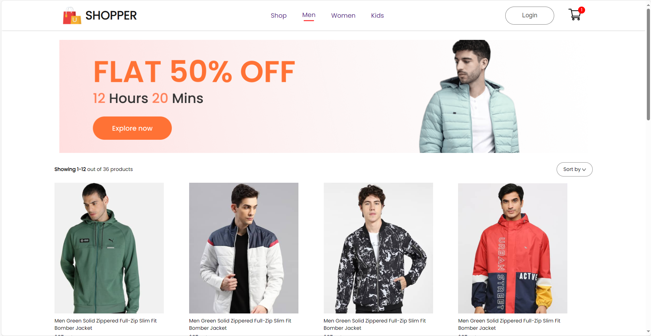
FEE-CS186
ETE PROJECT :
(E - commerce website) Aakashdeep Singh Sedha
Roll no: 2110990007
G-5

Slide 2
Outline
Introduction
Solution
Next Steps

Slide 3
The Introduction

Slide 4

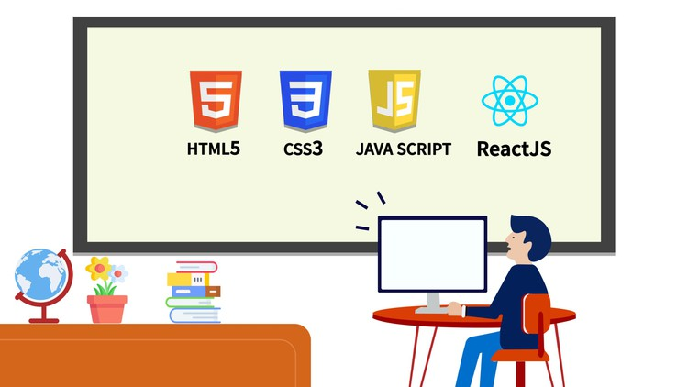
SHOPPER
"Front-End Development: Enhancing User Experiences for e-commerce website with HTML, CSS, JavaScript, and React."
This project represents a culmination of my efforts to explore and apply front-end technologies to create impactful user experiences.

Slide 5
Solution Proposal

Slide 6
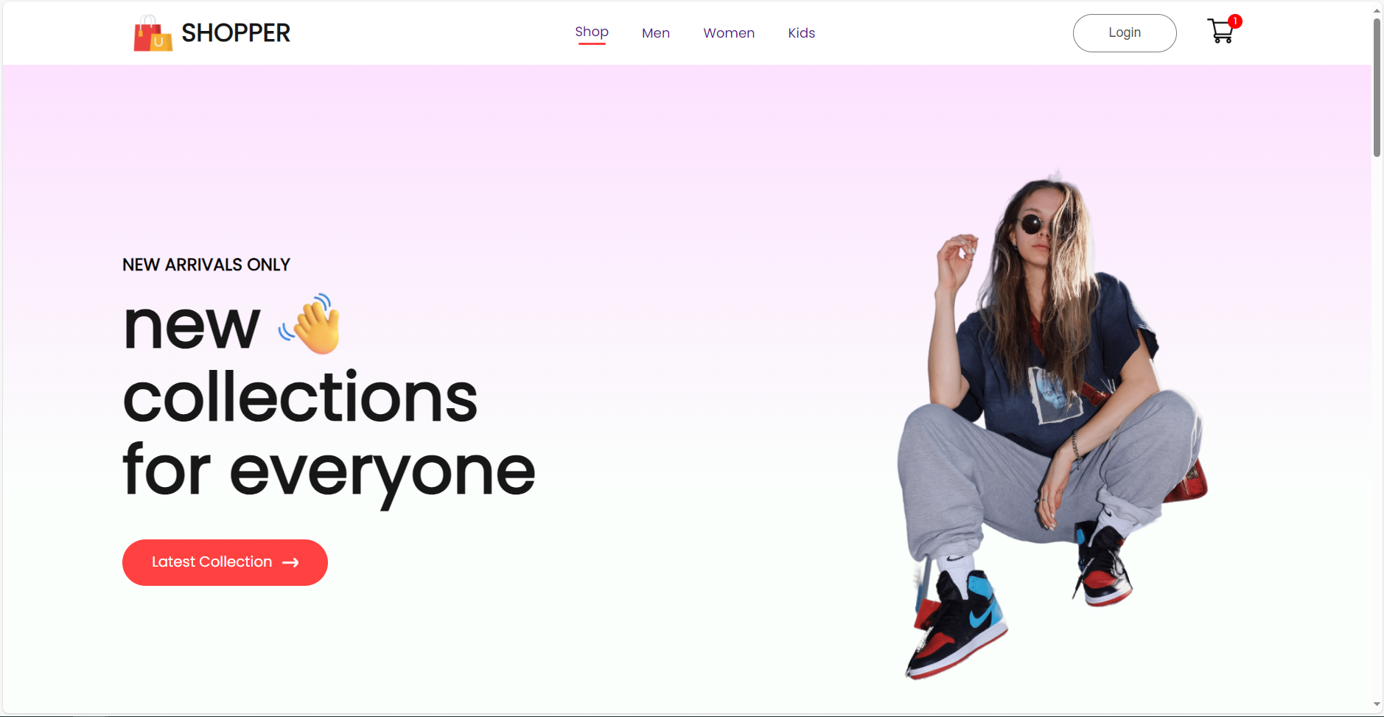
LOGIN
CART
NAVIGATION BAR
REACT ROUTER

Slide 7
Solution description
1. Dynamic Product Card Rendering:
- Leveraging dynamic rendering techniques to display product cards that adapt to user interactions.
2. Dynamic Product Pages:
- Employing the same dynamic rendering principles to create product pages that respond to user engagement.
3. Integrated Cart Functionality with Redux:
- Seamlessly integrating shopping cart functionality using Redux, ensuring efficient state management.
4. Seamless Web Performance:
- Ensuring a smooth and responsive website experience through optimization and performance enhancements.

Slide 8
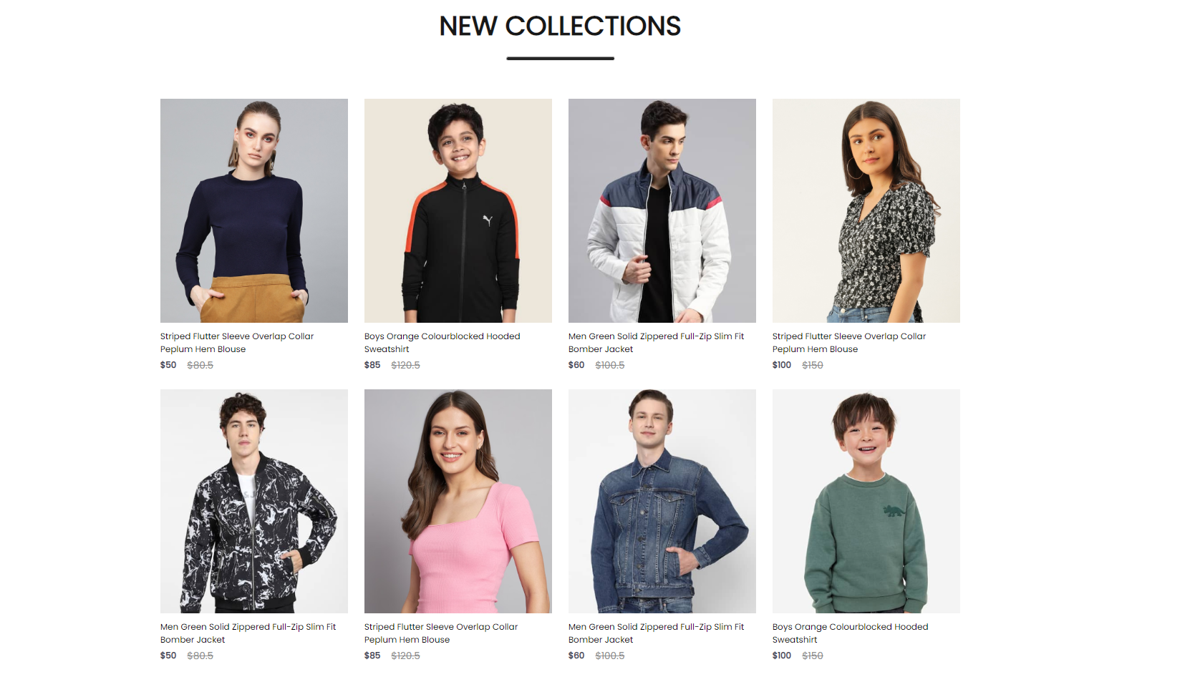
New Section
Dynamically
Rendered product cards
Using
Functional components

Slide 9

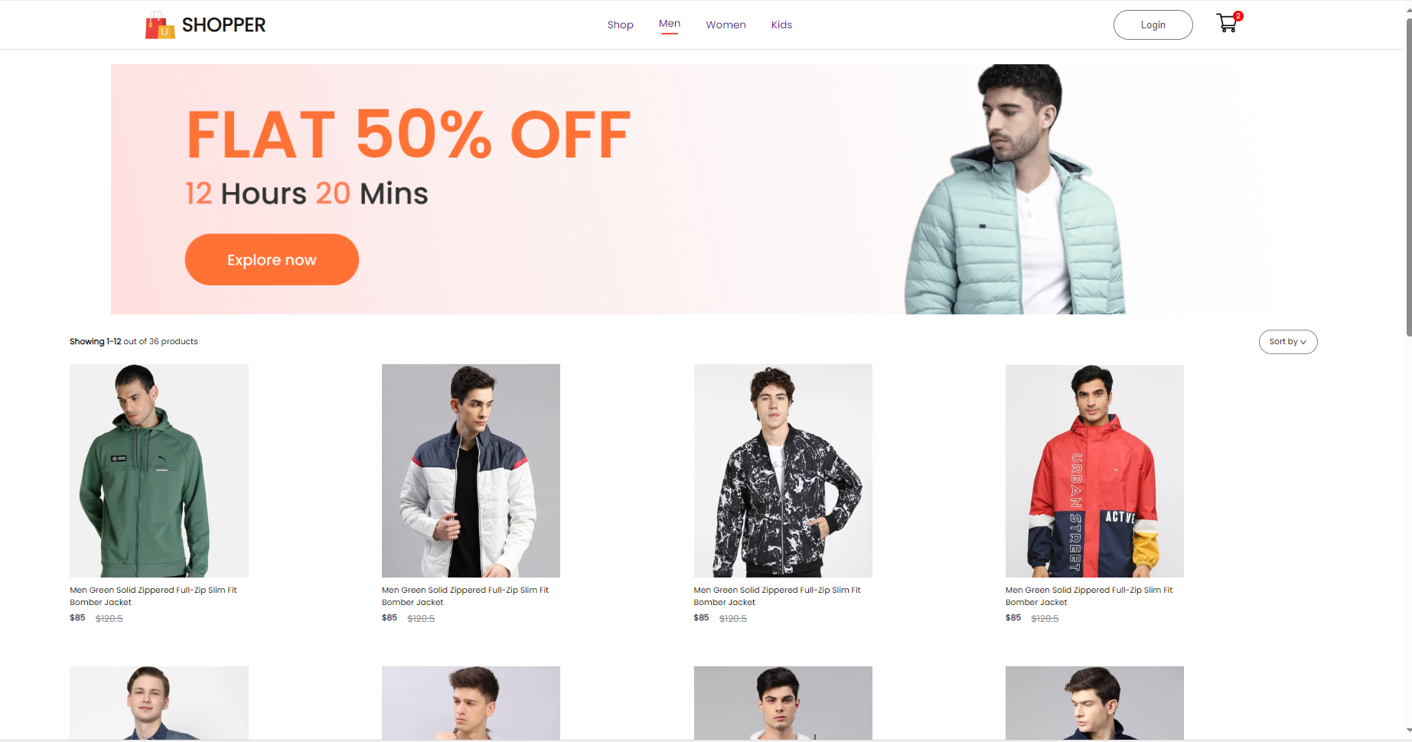
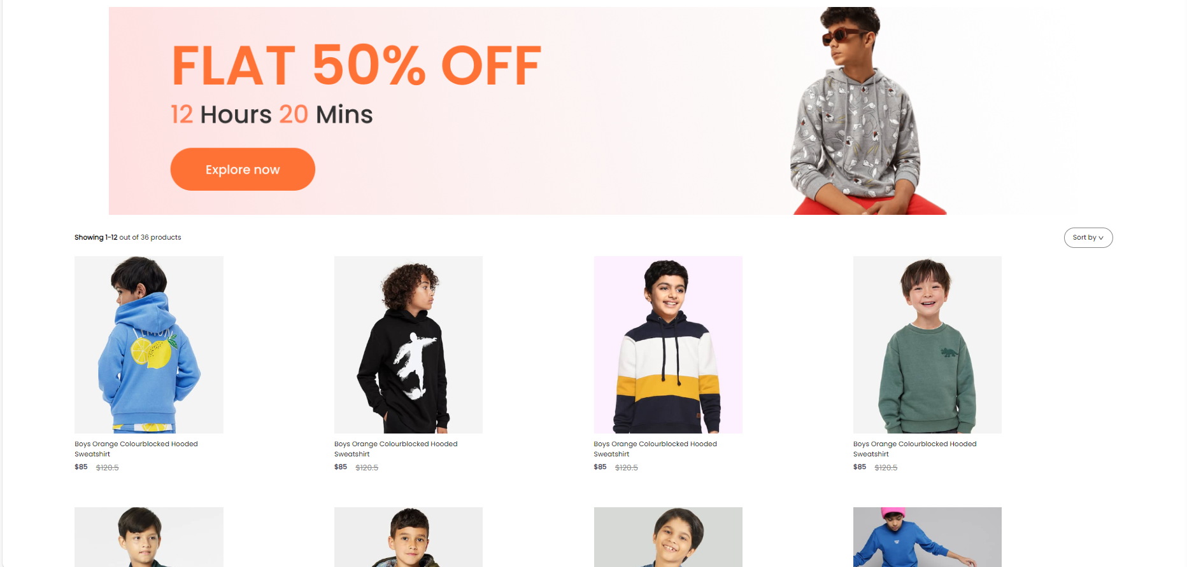
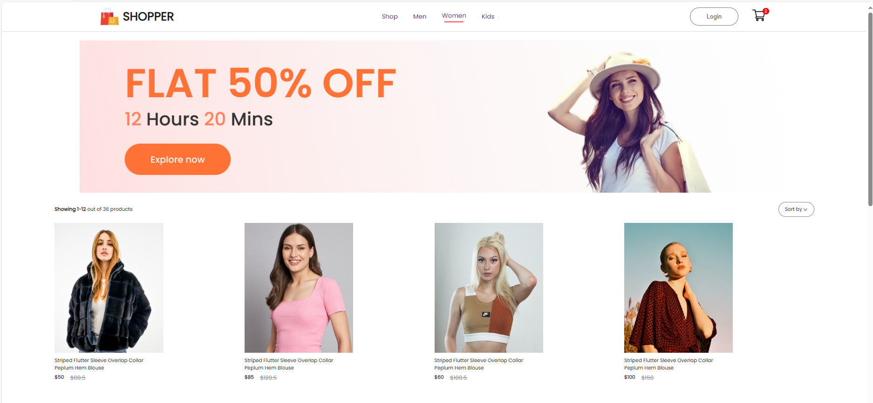
CATEGORIES OPTION

Slide 10
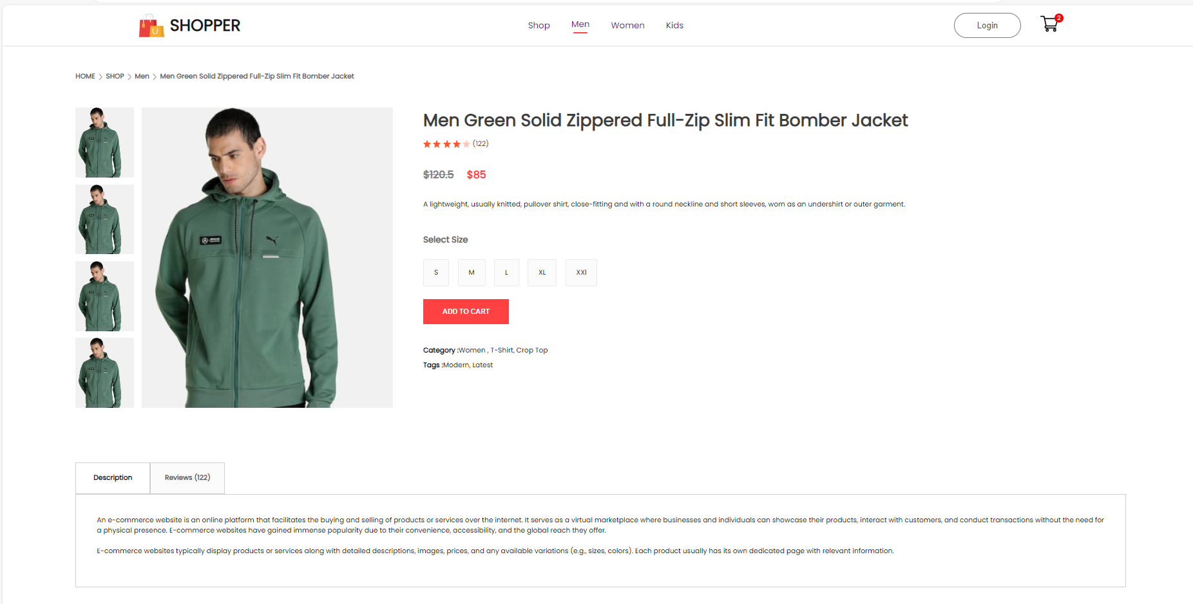
The entire page and product description is dynamically rendered
Add to cart (functionality)
Using redux

Slide 11
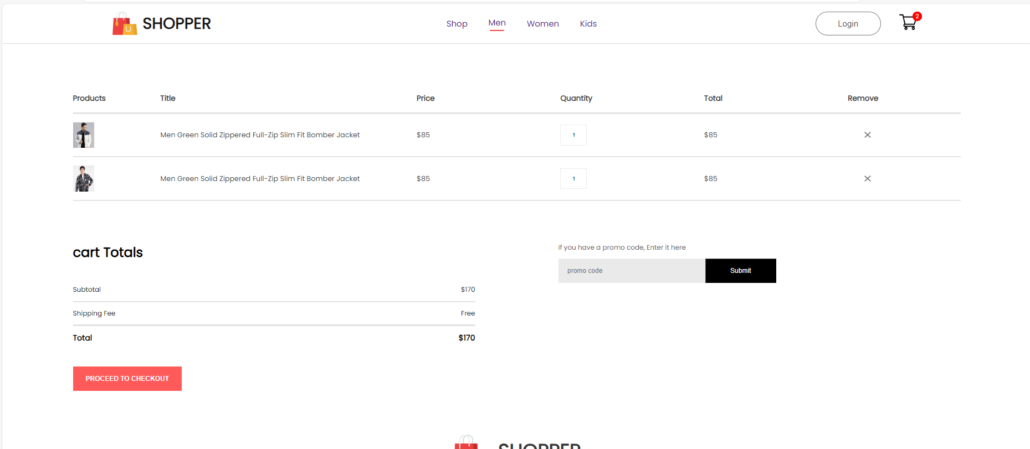
The cart ui - updates when we add/remove products.
State , SetState,
React-redux

Slide 12
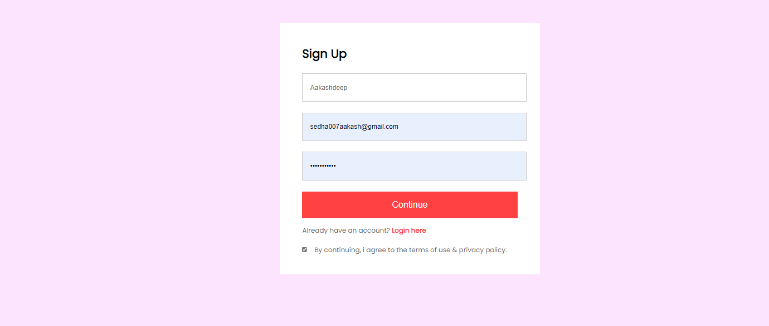
SIGNUP / LOGIN PAGE

Slide 13
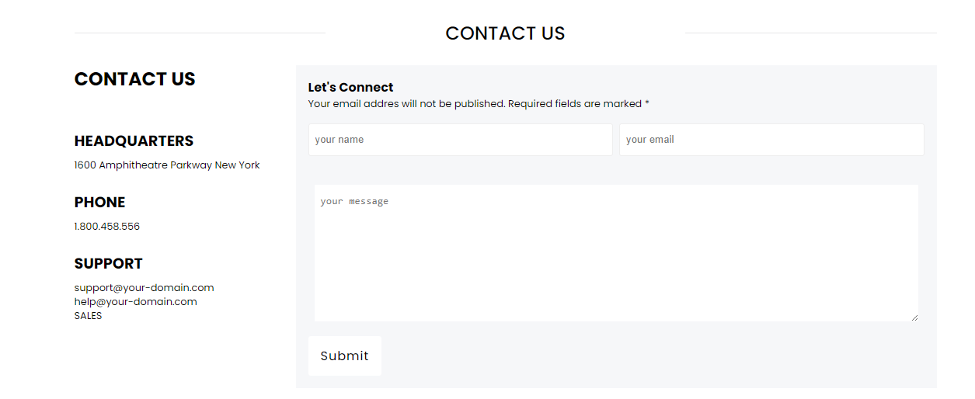
CONTACT US PAGE

Slide 14
THANK YOU VERY MUCH

